Slide 1
How to Remove ICA Components
By Sophia Snipes, for LSM study

Slide 2
How to
Using EEGLAB’s GUI

Slide 3
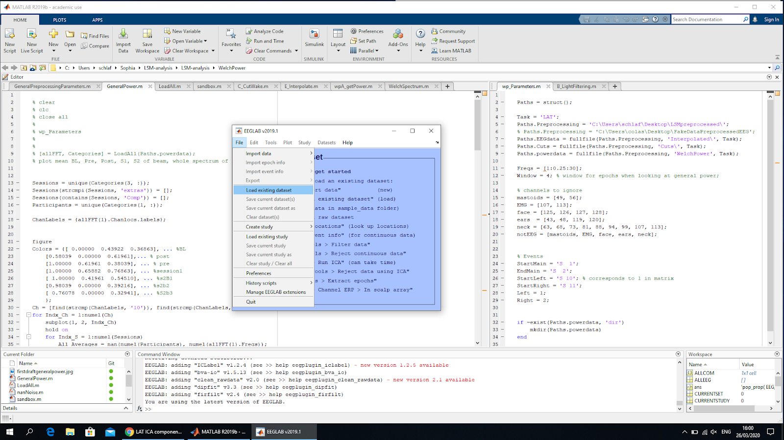
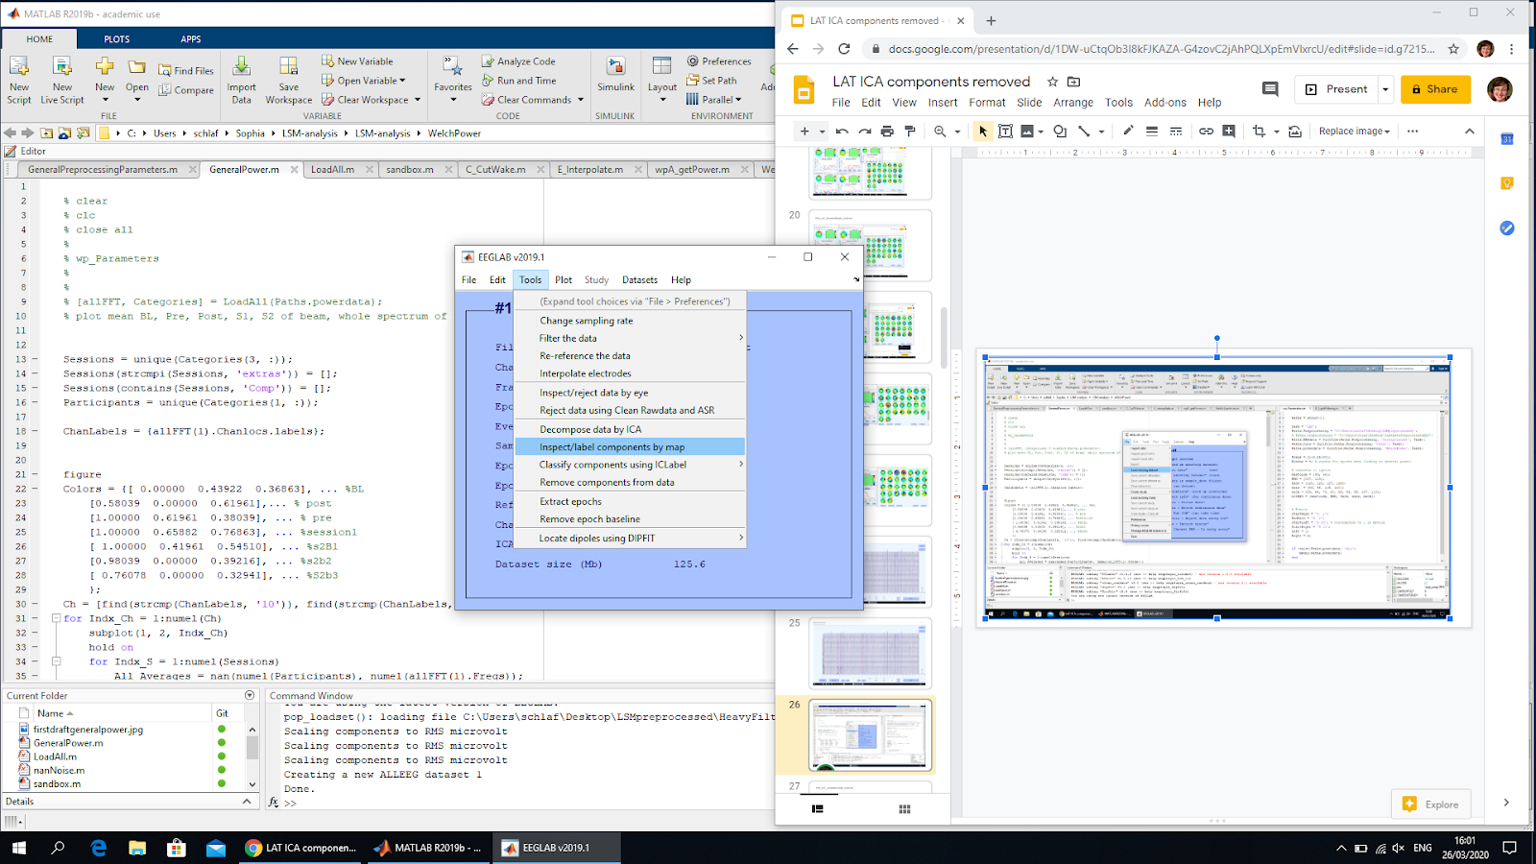
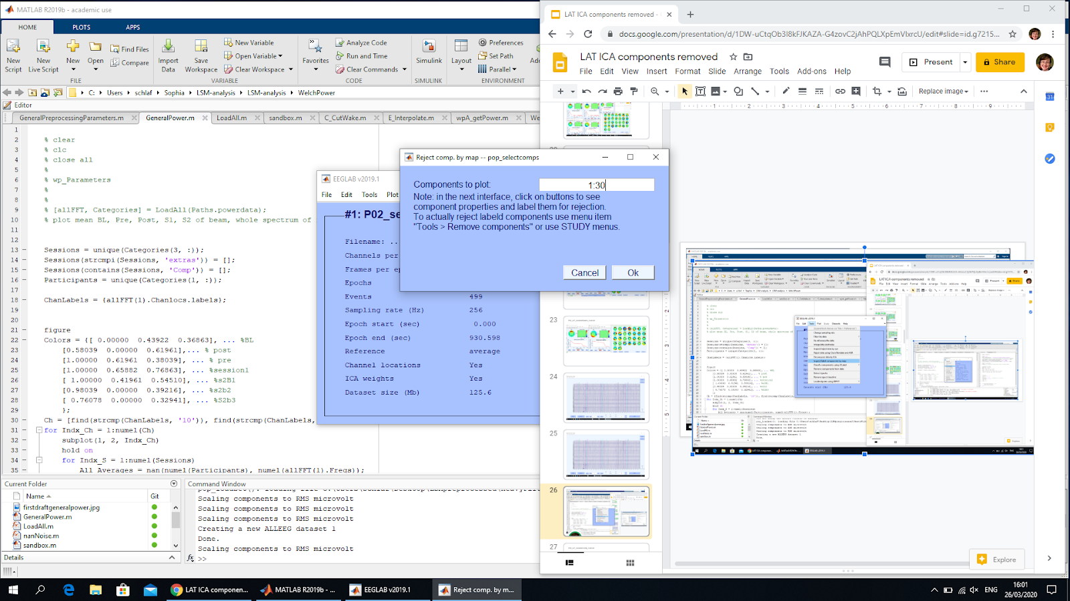
1) Load a dataset from “HeavyFiltered”
2) Click this
3) This popup appears
4) Write in 1:30 (default is 1:128)
5) Click ok

Slide 4
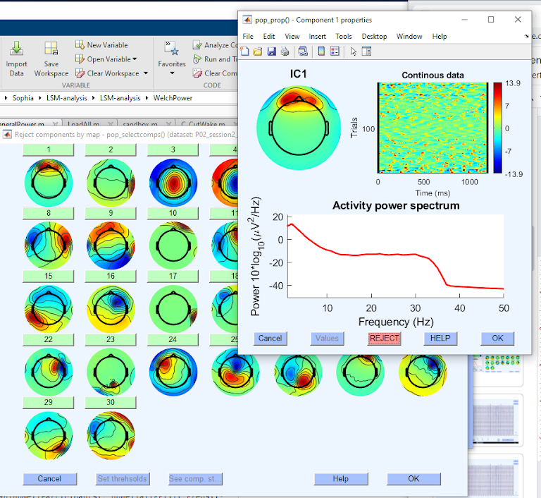
1) Click on the bar with the number to inspect a component
2) This window will appear, use it to determine if you need to remove component
3) Click accept (turns to reject in red, click again to keep)
3) Click ok
5) Click ok when finished with all components
4) Now this will be highlighted in red

Slide 5
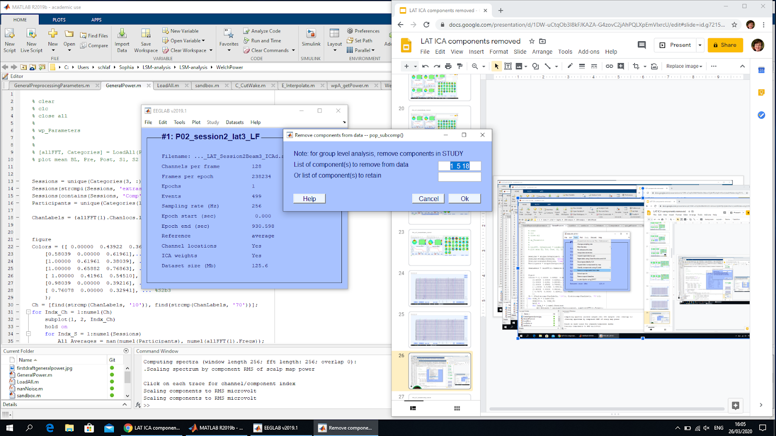
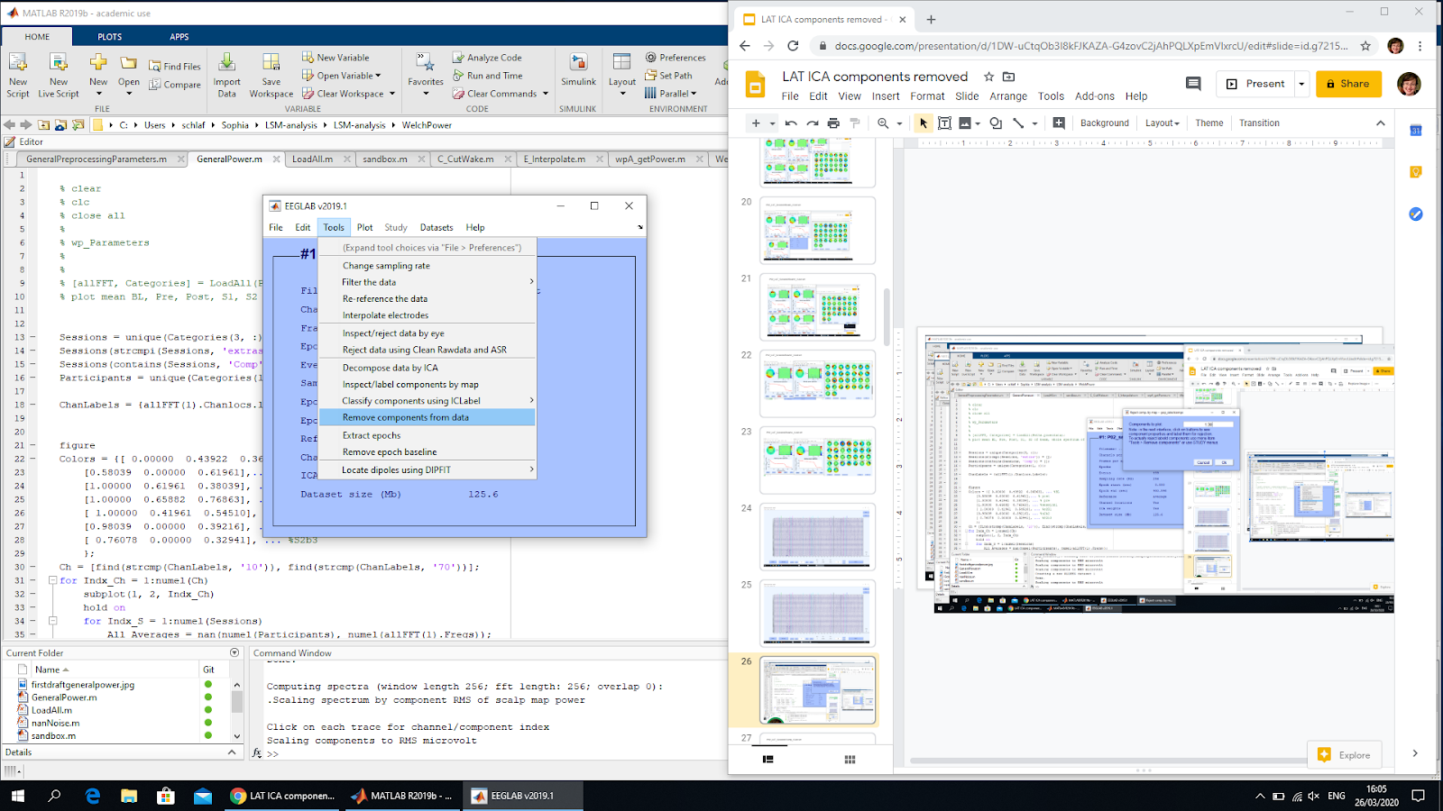
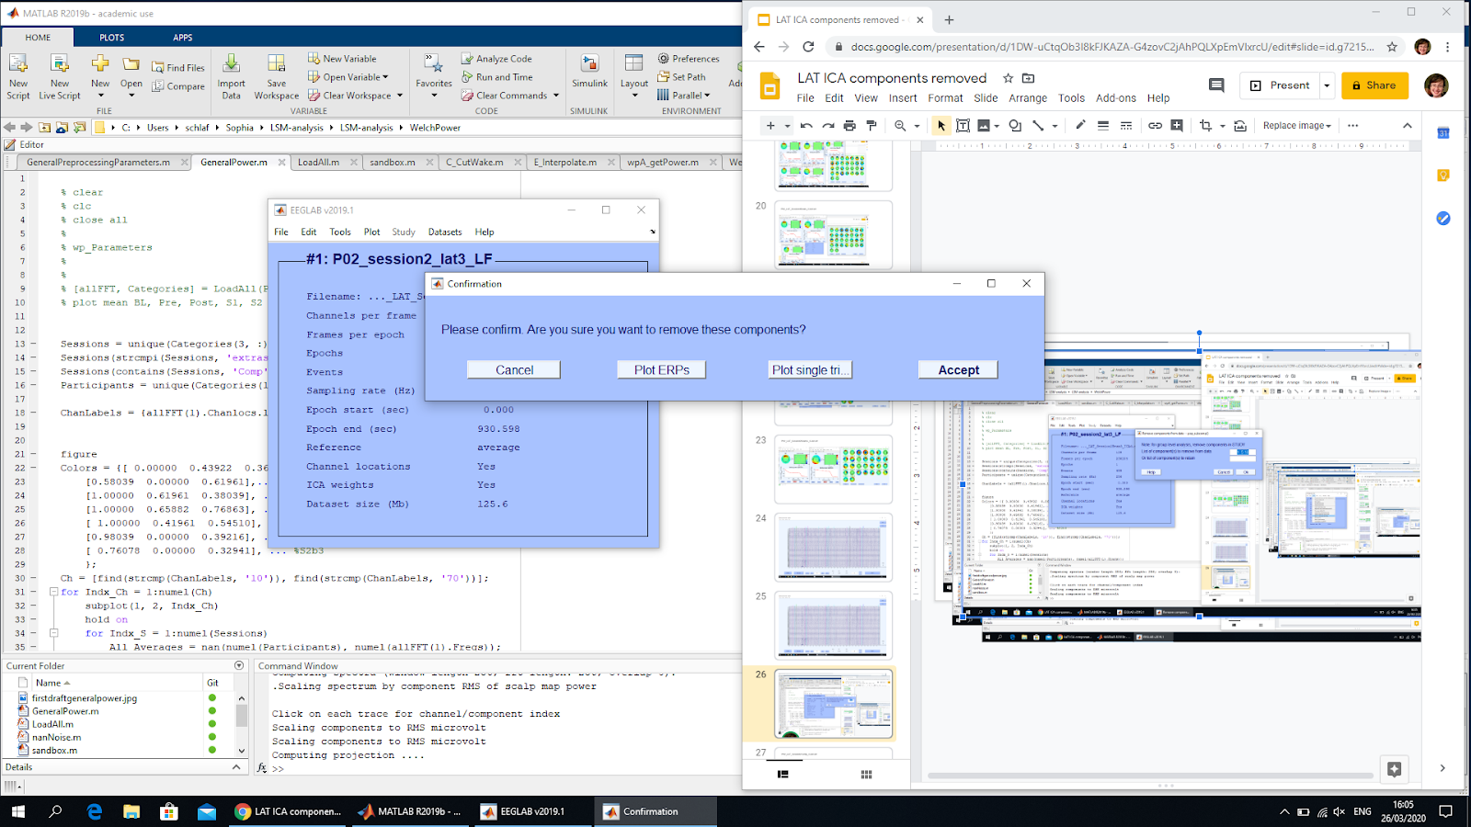
2) This popup appears
1) Click this
3) Ctrl+C numbers for later
4) If any are missing, just add to list
5) Click ok
6) This popup appears
7) Click accept

Slide 6
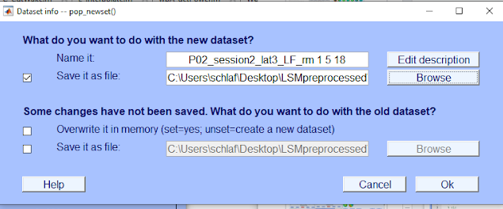
1) Rename end of file to list the numbers of the components removed
2) Save file with same name as original, but in “Deblinked” folder (create it if it doesn’t exist, and again inside deblinked have the task folder, so: Preprocessed>Deblinked>LAT>{all files})
3) Click ok. You’re done! But maybe check EEG with “Scroll View” to make sure everything is ok

Slide 7
Components to reject

Slide 8
Criterion for ICA components to remove
Maximum top 5 eye channels
Identified as blobs in the eye region, and nothing elsewhere in the topoplot
Needs to be spread out in time (as shown in “trials” plot); single event components are ignored (because cut out later)
Power spectrum needs to look very non-brainlike
Maximum top 2 heartbeat channels
Identified by lopsided halo look, and regular dots in trials plot

Slide 9
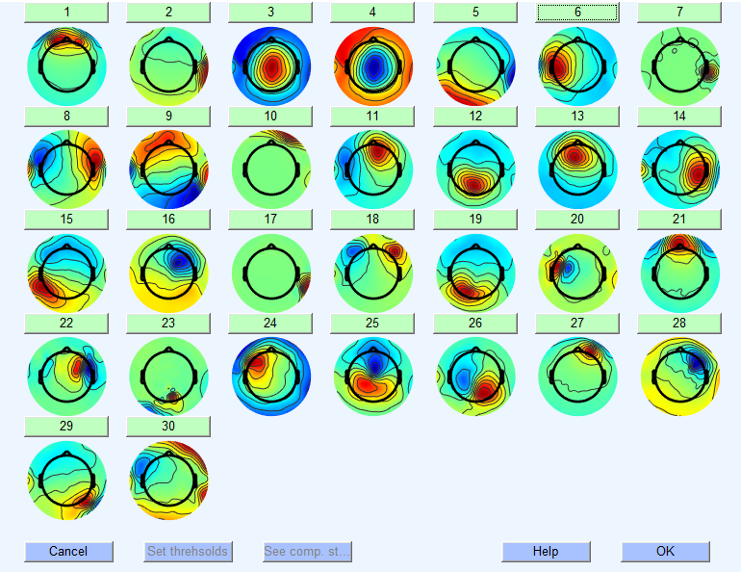
Components in an orange square should be selected for closer inspection

Slide 10
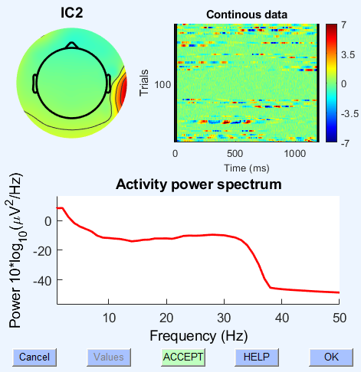
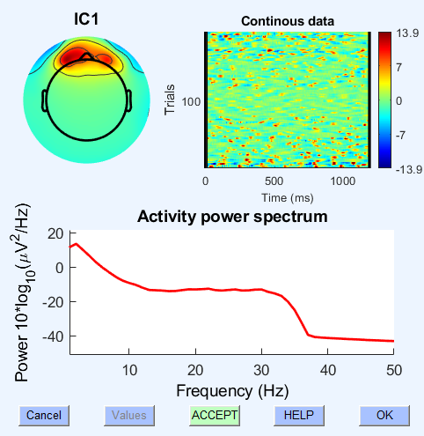
Topoplot: frontal blobs indicate eye artefact
large scale indicates big effects
These are channels 107 and 113, the EMG
Trials plot: regular dots indicate blinks
Power spectrum: weird spectrum indicates not-brain activity
Keep component
Given location, it’s an EMG artefact, but not a blink or heartbeat, so leave it in there
Reject component
Clearly a blink artefact, distributed in time

Slide 11
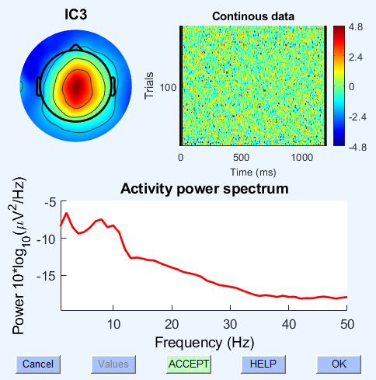
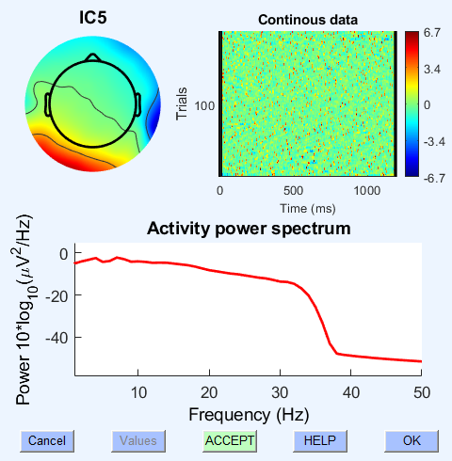
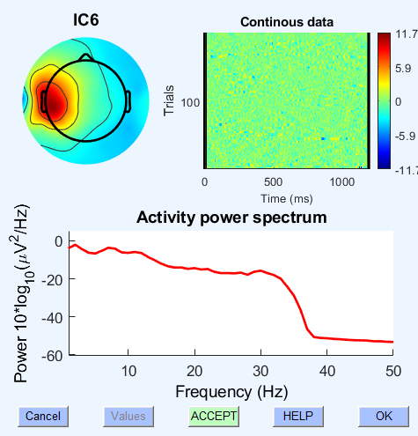
Keep component
Given spectrum, it’s probably noise, but no idea what, so leave it.
Reject component
This is a heartbeat artefact, as mainly evident by the weird “topography” and the fairly evenly spaced little dots in the trials plot.
Keep component
This could easily be brain data

Slide 12
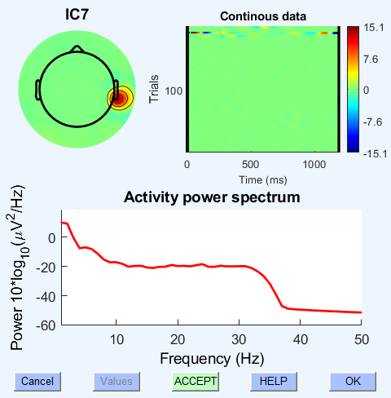
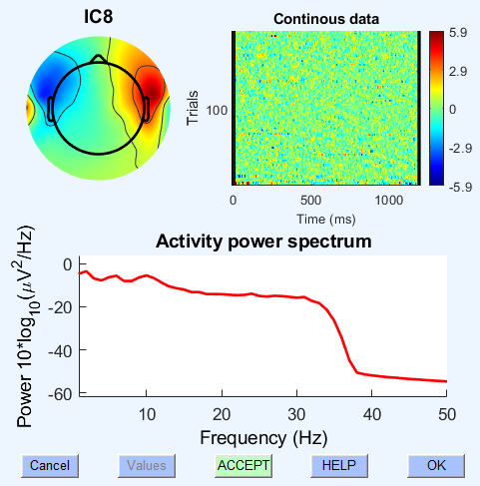
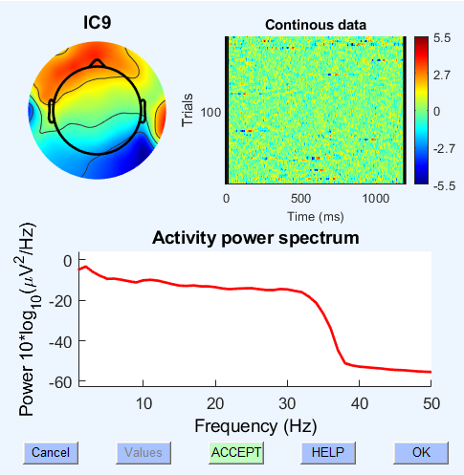
Keep component
This is a single channel gone wonky, probably just some single big movement at the end of the recording.
Keep component
This could be brain activity, given the spectrum; maaaybe eye movement, but not likely.
Keep component
This is likely a mix of data and noise, so leave it.

Slide 13
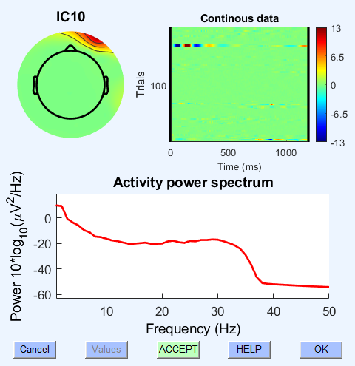
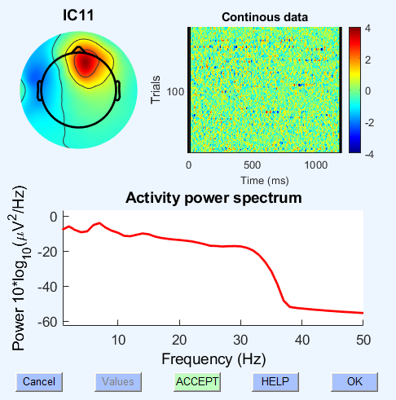
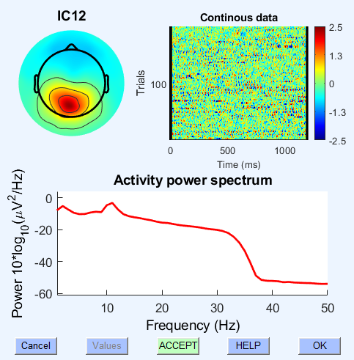
Keep component
This is definitely noise, likely from one of the face electrodes, but especially not to be rejected because it affects only a little chunk of time.
Keep component
This is theta, the main point of this experiment; do NOT get rid of it!
Keep component
This is definitely occipital alpha. Also don’t get rid of it.

Slide 14
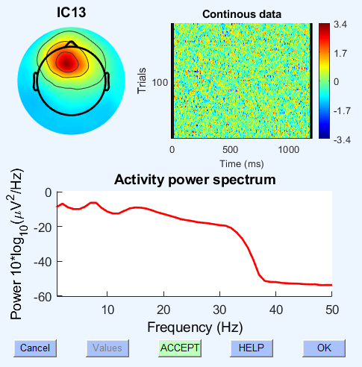
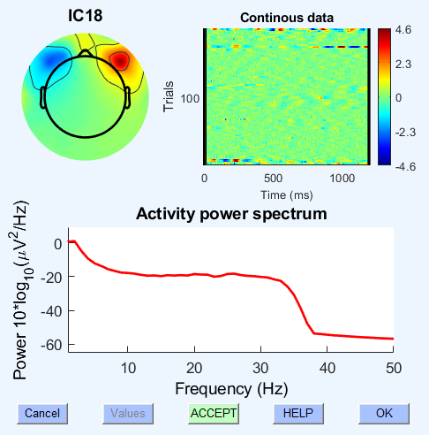
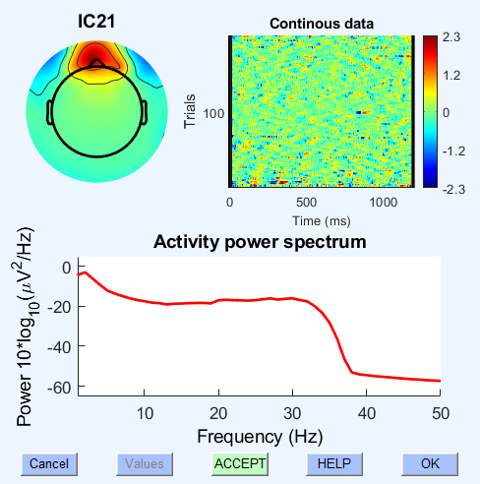
Keep component
Again, frontal theta, worth keeping.
Reject component
These are lateral eye movements; it’s often the case that they mainly occur just at the beginning and end of the recording, because otherwise the participant is fixating, but you can see there’s still little eye twitches throughout.
Reject component
This is also eye data, but I don’t really know what kind. Be careful though, because its not terribly different from frontal theta. If unsure, and the magnitude isn’t so big, leave it in.

Slide 15
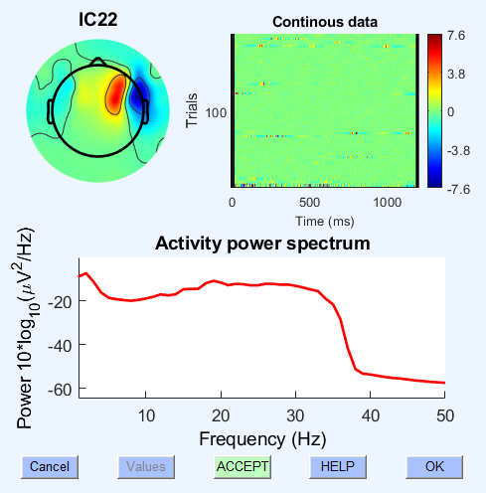
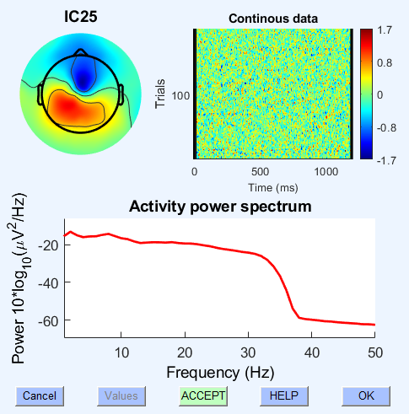
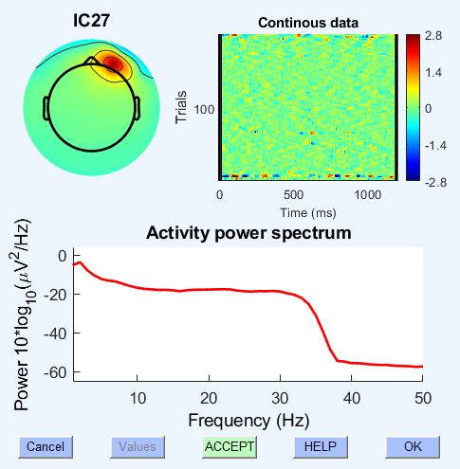
Keep component
Given spectrum, it’s probably noise, but no idea what, so leave it.
Keep component
No idea what it could be, so leave it.
Keep component
This could be eye data, but given that it’s just from 1 channel, leave it.

Slide 16
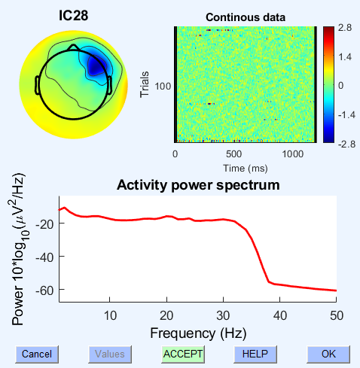
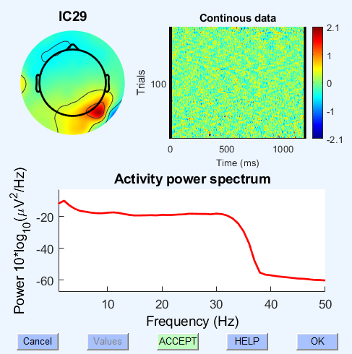
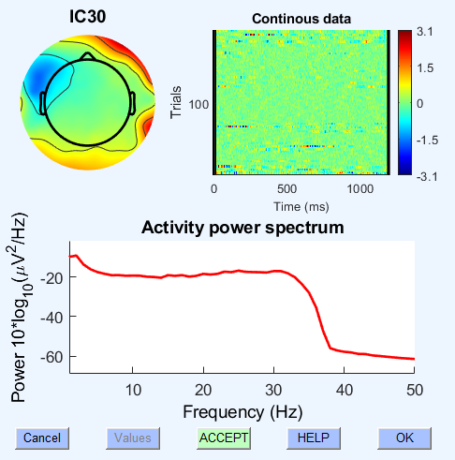
Keep component
No idea what it is, leave it.
Keep component
No idea what it is, leave it.
Keep component
No idea what it is, leave it.

